Slide 1
Chap. 6 Elements of Object Oriented Design

Slide 2
1. Definire OOD (Object Oriented Design)
Rezultatele analizei s-au concretizat in:
functional model – diagrama cazurilor de utilizare, diagrama de activitati, descrierea detaliata a cazurilor de utilizare
structural model – diagrama de clase ce include clasele specifice domeniului problemei
behavioral model – diagrama de stari, diagramele de interactiune
Proiectarea OO presupune rafinarea (detalierea) reultatelor analizei prin includerea unor detalii rezultate in urma activitatilor de proiectare a:
interfetei utilizator
bazei de date
arhitecturii logice
ea mai presupune aplicarea unor concepte si principii specifice
Aplicarea unor criterii de proiectare – cuplarea si coeziunea
aplicarea unor concepte precum clase abstracte si interfete
aplicarea design patterns si principii GRASP

Slide 3
1. Definire OOD (Object Oriented Design)
Rezultatele proiectarii OO se vor concretiza in:
completarea modelului structural prin adaugarea de clase specifice straturilor asplicatiei, proiectarea metodelor din clase, specificarea navigabilitatii relatiilor de asociere
detalierea modelului comportamental prin rafinarea interactiunilor intre obiecte
Procesul de rafinare (detaliere) in proiectarea OO este iterativ si incremental

Slide 4
2. Criterii de calitate in OOD
“A good design is one that balances trade-offs to minimize the total cost of the system over its entire lifetime.”
Criteriile de calitate a rezultatelor proiectarii sunt:
cuplarea – descrie gradul de interconectare (legaturile) dintre module (clase, obiecte si metode)
doua tipuri de cuplare – de interactiune si de mostenire
coeziunea – masura legaturilor interne dintre componentele unui modul (clase, metode) - trei tipuri de coeziune:
la nivel de metoda – sa faca/indeplineasca un singur lucru/functie
la nivel de clasa – o clasa sa reprezinte un singur lucru
legata de relatiile de mostenire – sa se bazeze pe semantica de tip “a kind of”
connascence (co-dependenta) – descrie o relatie foarte stransa intre doua module (clase sau module) – modificarea uneia atrage foarte probabil modificarea celeilalte
este similara coeziunii insa presupune aplicarea unor diferite niveluri de incapsulare
(Vezi detalii privind cuplarea si coeziunea in suportul de curs, cap.8)

Slide 5
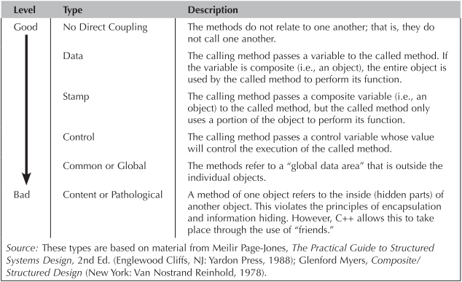
2. Criterii de calitate in OOD. Tipuri de cuplare de interactiune

Slide 6
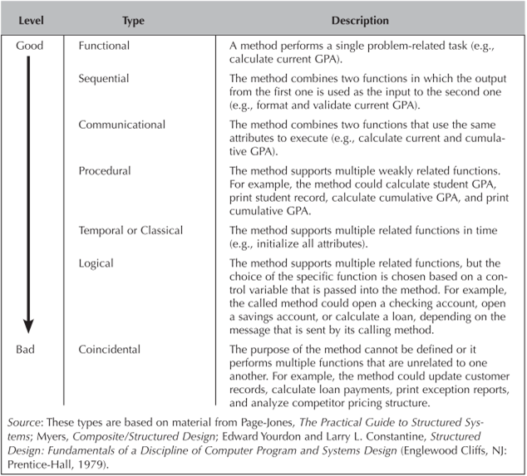
2. Criterii de calitate in OOD. Tipuri de coeziune la nivel de metoda

Slide 7
2. Criterii de calitate in OOD
“A good design is one that balances trade-offs to minimize the total cost of the system over its entire lifetime.”
Criteriile de calitate a rezultatelor proiectarii sunt:
cuplarea – descrie gradul de interconectare (legaturile) dintre module (clase, obiecte si metode)
doua tipuri de cuplare – de interactiune si de mostenire
coeziunea – masura legaturilor interne dintre componentele unui modul (clase, metode) - trei tipuri de coeziune:
la nivel de metoda – sa faca/indeplineasca un singur lucru/functie
la nivel de clasa – o clasa sa reprezinte un singur lucru
legata de relatiile de mostenire – sa se bazeze pe semantica de tip “a kind of”
connascence (co-dependenta) – descrie o relatie foarte stransa intre doua module (clase sau module) – modificarea uneia atrage foarte probabil modificarea celeilalte
este similara coeziunii insa presupune aplicarea unor diferite niveluri de incapsulare
(Vezi detalii privind cuplarea si coeziunea in suportul de curs, cap.8)

Slide 8
3. Principii GRASP. Introducere
Most simply, a good pattern is a named and well-known problem/solution pair that can be applied in new contexts, with advice on how to apply it in novel situations and discussion of its trade-offs, implementations, variations, and so forth.
Consequently, the GRASP patterns don't state new ideas; they name and codify widely used basic principles
GRASP – General Responsibility Assignment Software Patterns
There are nine GRASP patterns:
Creator | Controller | Pure Fabrication
Information Expert | High Cohesion | Indirection
Low Coupling | Polymorphism | Protected Variations

Slide 9
3.1 Creator
Problem:
Who should be responsible for creating a new instance of some class?
Solution:
Assign class B the responsibility to create an instance of class A if one of these is true:
B "contains" or compositely aggregates A
B records A
B closely uses A
B has the initializing data for A that will be passed to A when it is created
Benefits:
low coupling is supported, which implies lower maintenance dependencies
higher opportunities for reuse
Example (cazul d):
assume that a Payment instance, when created, needs to be initialized with the Sale total
since Sale knows the total, Sale is a candidate creator of the Payment.
Notes:
The basic intent of the Creator pattern is to find a creator that needs to be connected to the created object in any event. Choosing it as the creator supports low coupling. Cu alte cuvinte, daca deja clasa A este strans legata de clasa B (unul dintre cele 4 motive enumerate in slide), atunci de ce nu ar fi clasa B responsabila cu instantierea clasei A, avand in vedere ca acest fapt nu adauga un grad de cuplare suplimentar intre cele 2 clase. Daca o a 3-a clasa ar fi responsabila cu instantierea clasei A, atunci s-ar putea introduce un nivel de cuplare suplimentar fata de cel existent intre clasele C si A.
Exemple (cazul a):
Factura si LinieFactura; Produs si MateriePrima;
Controller si clasele Entity

Slide 10
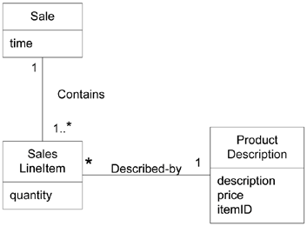
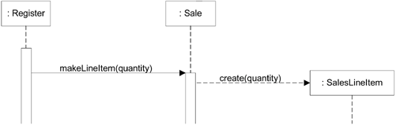
3.1 Creator
Example: relatia “Contains” sugereaza rolul de “creator” al clasei Sales
Atribuirea responsabilitatii de creare se concretizeaza prin definirea metodei makeLineItem() in clasa Sale, care va invoca constructorul SalesLineItem.
Notes:
Diagrama de clase reprezinta o parte a Domain Model. Altfel, relatia dintre Sale si SalesLineItem putea fi reprezentata ca fiind de compozitie.

Slide 11

3.2 Information Expert
Problem:
What is a general principle of assigning responsibilities to objects?
Solution:
Assign a responsibility to the information expert, the class that has the information necessary to fulfill the responsibility
Example:
Who should be responsible for knowing the grand total of a sale?
Design Class | Responsibility
Sale | knows sale total
SalesLineItem | knows line item subtotal
ProductDescription | knows product price

Slide 12
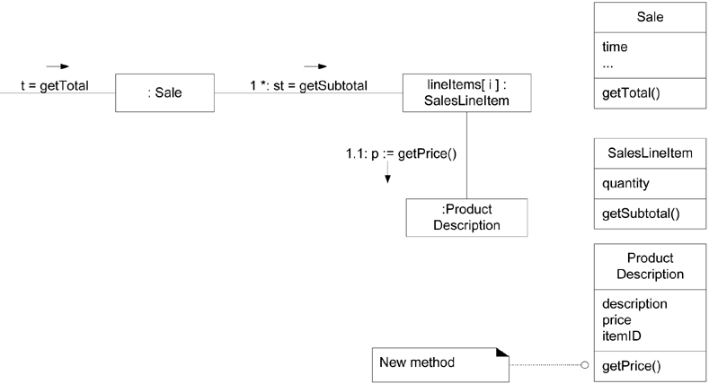
3.2 Information Expert
Benefits:
low coupling - information encapsulation is maintained since objects use their own information to fulfill tasks
high cohesion - behavior is distributed across the classes that have the required information

Slide 13
3.3 Low coupling
Problem:
How to support low dependency, low change impact, and increased reuse?
Solution:
Assign a responsibility so that coupling remains low. Use this principle to evaluate alternatives
the common forms of coupling from TypeX to TypeY include the following:
TypeX has an attribute that refers to a TypeY instance
A TypeX object calls on services of a TypeY object
TypeX has a method that references an instance of TypeY (include a parameter or local variable of type TypeY, or the object returned from a message being an instance of TypeY)
TypeX is a direct or indirect subclass of TypeY
TypeY is an interface, and TypeX implements that interface.
Example:
Assume we need to create a Payment instance and associate it with the Sale.
What class should be responsible for this? Register, Sale or Payment?

Slide 14
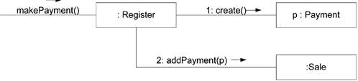
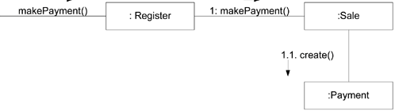
3.3 Low coupling
Care varianta de proiectare este mai buna?
Varianta 1
Varianta 2
Benefits:
not affected by changes in other components
simple to understand in isolation
convenient to reuse
Atentie:
Gradul mare de cuplare nu este o problema in sine, ci cuplarea mare cu parti instabile (cum ar fi interfata utilizator)
Notes:
In analiza celor 2 variante de proiectare se porneste de la premisa ca clasele Sale si Payment sunt asociate, iar clasa Sale are un atribut de tip Payment. Asadar, oricum ar fi va exista o cuplare intre cele 2 clase. In acest context, varianta 1 este mai putin buna deoarece introduce o cuplare intre clasele Register si Payment (clasa Register trebuie sa stie despre clasa Payment). In varianata 2 aceasta cuplare nu exista, fiind inlocuita cu cea dintre Sale si Payment, care oricum exista si inainte de implementarea acestei functionalitati. In aceasta varianta clasa Register nu stie nimic despre clasa Payment.

Slide 15
3.4 Controller
Problem:
What first object beyond the UI layer receives and coordinates /controls a system operation?
A controller is the first object beyond the UI layer that is responsible for receiving or handling a system operation message
Solution:
Assign the responsibility to a class representing one of the following choices::
Represents the overall "system
Represents a use case scenario within which the system event occurs, often named <UseCaseName>Handler, <UseCaseName>Coordinator, or <UseCaseName>Session
Use the same controller class for all system events in the same use case scenario
Normally, a controller should delegate to other objects the work that needs to be done; it coordinates or controls the activity. It does not do much work itself

Slide 16
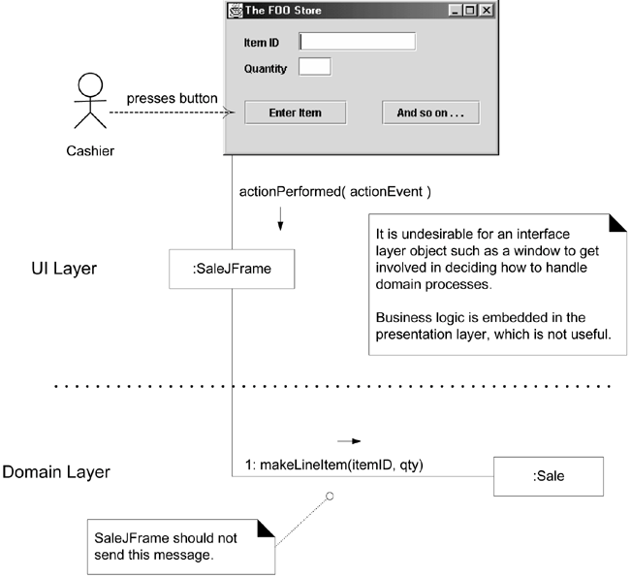
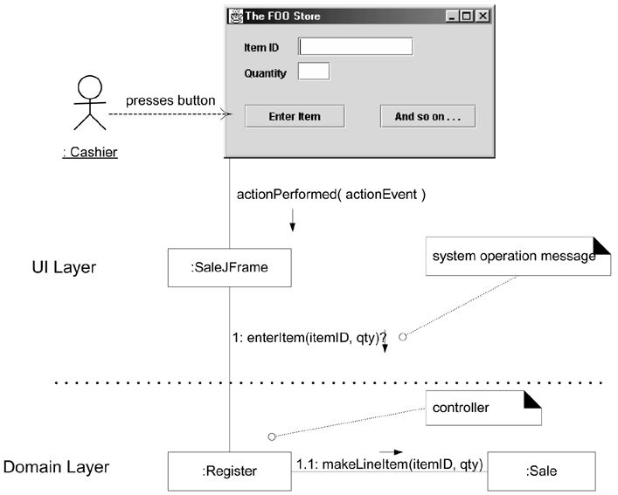
3.4 Controller
Exemplu
Varianta de proiectare corecta
Varianta de proiectare gresita
Benefits:
Increased potential for reuse and pluggable interfaces
Opportunity to reason about the state of the use case

Slide 17
3.5 High cohesion
Problem:
How to keep objects focused, understandable, and manageable, and as a side effect, support Low Coupling?
Solution:
Assign a responsibility so that cohesion remains high. Use this to evaluate alternatives
cohesion (functional cohesion) is a measure of how strongly related and focused the responsibilities of an element are
a class with high cohesion has a relatively small number of methods, with highly related functionality, and does not do too much work.
Benefits:
Clarity and ease of comprehension of the design is increased.
Maintenance and enhancements are simplified.
Low coupling is often supported.
Reuse of fine-grained, highly related functionality is increased
Notes:
It is a common observation that if a person takes on too many unrelated responsibilities, especially ones that should properly be delegated to others, then the person is not effective. This is observed in some managers who have not learned how to delegate. These people suffer from low cohesion; they are ready to become "unglued.“

Slide 18
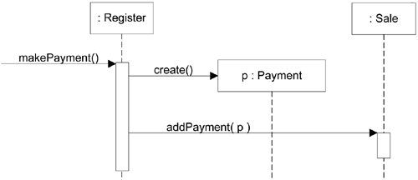
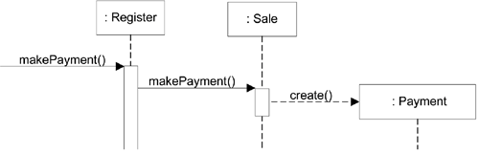
3.5 High cohesion

Slide 19
3.6 Polymorfism
Problem:
How handle alternatives based on type?
If a program is designed using if-then-else or case statement conditional logic, then if a new variation arises, it requires modification of the case logic, often in many places.
How to create pluggable software components?
Viewing components in client-server relationships, how can you replace one server component with another, without affecting the client?
Solution:
assign responsibility for the behavior, using polymorphic operations, to the types for which the behavior varies
Do not test for the type of an object and use conditional logic to perform varying alternatives based on type
Notes:
Polymorphism implies the presence of abstract superclasses or interfaces in most OO languages. When should you consider using an interface? The general answer is to introduce one when you want to support polymorphism without being committed to a particular class hierarchy. If an abstract superclass AC is used without an interface, any new polymorphic solution must be a subclass of AC, which is very limiting in single-inheritance languages such as Java and C#. As a rule-of-thumb, if there is a class hierarchy with an abstract superclass C1, consider making an interface I1 that corresponds to the public method signatures of C1, and then declare C1 to implement the I1 interface. Then, even if there is no immediate motivation to avoid subclassing under C1 for a new polymorphic solution, there is a flexible evolution point for unknown future cases.

Slide 20
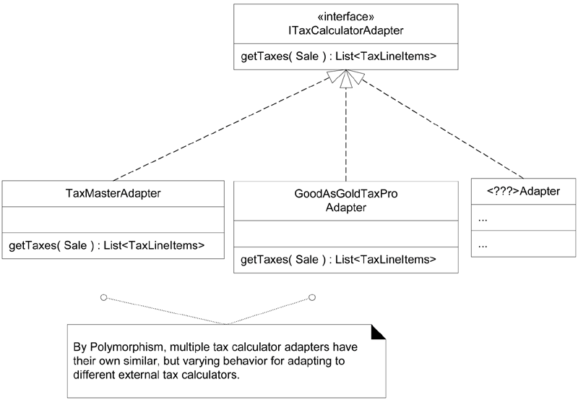
3.6 Polymorfism
Example:
there are multiple external third-party tax calculators that must be supported
Each tax calculator has a different interface or API
one product may support a raw TCP socket protocol, another may offer a SOAP interface, and a third may offer a Java RMI interface

Slide 21
3.6 Polymorfism
Benefits:
Extensions required for new variations are easy to add - adding a new calculator adapter class with its own polymorphic getTaxes() method will have minor impact on the existing design
New implementations can be introduced without affecting clients.

Slide 22
3.7 Pure fabrication
Problem:
What object should have the responsibility, when you do not want to violate High Cohesion and Low Coupling, or other goals, but solutions offered by Expert (for example) are not appropriate?
there are many situations in which assigning responsibilities only to domain layer software classes leads to problems in terms of poor cohesion or coupling, or low reuse potential
Solution:
assign a highly cohesive set of responsibilities to an artificial or convenience class that does not represent a problem domain concept
such a class is a fabrication of the imagination
Example:
Suppose that support is needed to save Sale instances in a relational database.
the Sale class has to be coupled to the relational database interface (such as JDBC in Java technologies)
Placing these responsibilities in the Sale class suggests there is going to be poor reuse or lots of duplication in other classes that do the same thing

Slide 23
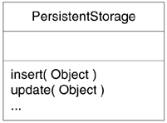
3.7 Pure fabrication
Example (continued):
create a new class that is solely responsible for saving objects in some kind of persistent storage medium, such as a relational database
Benefits:
This Pure Fabrication solves the following design problems:
the Sale remains well-designed, with high cohesion and low coupling.
the PersistentStorage class is itself relatively cohesive, having the sole purpose of storing or inserting objects in a persistent storage medium.
the PersistentStorage class is a very generic and reusable object.
Many existing object-oriented design patterns are examples of Pure Fabrications:
Adapter, Strategy, Command etc.

Slide 24
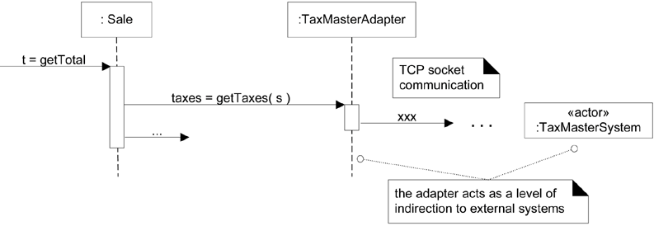
3.8 Indirection
Problem:
Where to assign a responsibility, to avoid direct coupling between two (or more) things?
How to de-couple objects so that low coupling is supported and reuse potential remains higher?
Solution:
Assign the responsibility to an intermediate object to mediate between other components or services so that they are not directly coupled
Many Indirection intermediaries are Pure Fabrications
Example:
the tax calculators problem
the save Sale instances problem
Notes:
TaxCalculatorAdapter
These objects act as intermediaries to the external tax calculators. Via polymorphism, they provide a consistent interface to the inner objects and hide the variations in the external APIs. By adding a level of indirection and adding polymorphism, the adapter objects protect the inner design against variations in the external interfaces.
PersistentStorage
The Pure Fabrication example of decoupling the Sale from the relational database services through the introduction of a PersistentStorage class is also an example of assigning responsibilities to support Indirection. The PersistentStorage acts as a intermediary between the Sale and the database.

Slide 25
3.9 Protected Variations
Problem:
How to design objects, subsystems, and systems so that the variations or instability in these elements does not have an undesirable impact on other elements?
Solution:
Identify points of predicted variation or instability and assign responsibilities to create a stable interface around them
The term "interface" is used in the broadest sense of an access view (not Java interface)
Example:
the tax calculators problem
The point of instability or variation is the different interfaces or APIs of external tax calculators
the solution - adding a level of indirection, an interface
Internal objects collaborate with a stable interface
the various adapter implementations hide the variations to the external systems
Notes:
Un exemplu mai general de aplicare a acestui principiu: la proiectarea orientata pe date se poate crea un strat de functionalitati care sa asigure accesul la baza de date; orice modul de aplicatie nu va face accesarea directa a unui camp dintr-o tabela a BD, ci indirect, prin intermediul unui modul; orice modificare in BD se va rasfringe doar asupra modulului care asigura accesul la BD, indiferent de cate locuri din aplicatie apeleaza la acest modul.

Slide 26
3.9 Protected Variations
Benefits:
Extensions required for new variations are easy to add.
New implementations can be introduced without affecting clients.
Coupling is lowered.
The impact or cost of changes can be lowered

Slide 27
Webografie
https://en.wikipedia.org/wiki/Cohesion_(computer_science)
https://en.wikipedia.org/wiki/Loose_coupling http://www.cs.cmu.edu/~aldrich/214/slides/design-grasp.pdf
http://www.cvc.uab.es/shared/teach/a21291/temes/object_oriented_design/slides/handouts/GRASP_patterns.pdf
examples.html#water-phase-diagram

